Slide 1



StarCDN: Moving Content Delivery Networks to Space
William X. Zheng, Aryan Taneja, Maleeha Masood,
Anirudh Sabnis, Ramesh K. Sitaraman, Deepak Vasisht
Notes:
Hello everyone. I’m William from UIUC and today I’m going to present our work – StarCDN. This is a joint work of UIUC, Akamai, and University of Massachusut

Slide 2



LEO networks are rapidly growing
7000 + satellites
4 million users
100Mbps+ speed
PBs of traffic
Question: Does existing internet infrastructure serve satellite users well?
Notes:
In the past decade, the number of satellites lauched per year is growing exponentially. This marks human’s access to space has become much easier then ever before. This allows companies like amazon, OneWeb, and Starlink to build the next generation, ubiquitous internet using low earth ortbit or LEO satellites. Today, the largest LEO network service provider Starlink has more than 7000 satellites covering almost every inch of the world. It serves more than 4 millions users with a service speed more than 100Mbps. In 2024 alone, Starlink served 50PB of traffic every month for just maritime users. As more and more users are being served by satellite networks, a natural question to raise is does existing internet infrastructure serve these satellite users well?

Slide 3

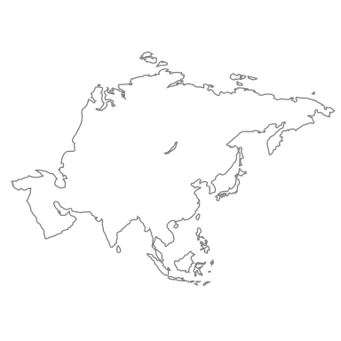







Content Delivery Networks (CDNs)
Reduce latency
Reduce WAN traffic
Origin
CDN edge
CDN edge
CDN edge
Notes:
In particular, I am going to focus on content delivery networks or CDNs which is one of the key internet infrastructures. It is designed to enhance the internet performance and reduce the cost of delivering content. [Animate CDN appear]CDN works via deploying countless edge servers around the world to cache and serve content from locations that are proximal to the users. [Animate remaining]The edge server is geographically close to clients to reduce latency and the content only needs to be fetched once for multiple deliveries to reduce WAN traffic.
Note: Use a better plot to demonstrate low latency
Note: animate the arrow

Slide 4





Terrestrial CDNs do not reduce satellite latency
For terrestrial CDNs, even cache hits need to go over 4 earth space links
GS
CDN
GS
Notes:
However, recent work has shown that terrestrial CDNs do not work well for satellite traffic and let me tell you why. The first problem is latency. Current LEO satellite networks operate in a bent-pipe architecture. What this means is that a user connects to a satellite, which in turn connects to the ground station. The ground station then connects to an edge server of the terrestrial CDN. [Animate content going from CDN-> GS->Satellite->User] When a user wants to watch some content, say Friends, then it will come from the CDN edge, to the GS, to the satellite, then to the user. [Animate new content flow] As you can see, I still have to go over the satellite link for each bit of content. [Animate more flows] This means that there is a long latency hop back and forth to space. Even if the CDN is close to me, I have to go all the way to the orbit and back so I do not end up getting the latency benefit of CDNs.
Note: Highlight link congestion
Note: Change color for uplink as more traffic go through. Change to a different show instead of game of throne.

Slide 5

Terrestrial CDNs do not reduce satellite congestion
Single GS serves 100s of users
Uplink bandwidth is a bottleneck
Terrestrial CDNs still need the uplink hop
GS
CDN
GS
Notes:
There is also a second problem with this. This uplink between the ground station to the satellite is being shared by many many users and is a bottleneck. Starlink spends a lot of time to apply for more bandwidth for earth-and-space links from FCC because these bandwidth are very precious. When people request content, they have to get the data from Earth every time and the uplink usage will be very high. I do not get any bandwidth efficiency for satellite links by using CDN, even the content is in the terrestrial CDN cahce. Therefore, we also lose the second benefit of CDNs. I was going to deploy CDN to improve latency and to improve my network efficiency, unfortunately, here I do not get any of these benefits. [pause for 3 seconds] What can we do here?

Slide 6
Our Idea: Let us put CDN edge servers in space
Notes:
Here is an idea. What if we put the CDN in space? [pause for 3 seconds] It is actually not that crazy. More and more companies are deploying computational and storage resources in space. In fact, modern satellites are just computers flying around in orbits.

Slide 7


Our idea: Let us put CDN edge servers in space
Reduce latency
Improve satellite link usages
cache hit
GS
CDN
GS
Notes:
This can bring back the advantages of CDNs that we wanted. [Animate cache server appear]By placing a cache server on the satellite, when the requested content is in the cache, the satellite can directly reply to the client and reduce the latency for users. If the cached content is not in the server, we can retrieve it from the terrestrial CDNs and save a replica on the satellite. If multiple users are requesting the same content, we can distribute the content from our satellite cache directly. I do not need to keep using the uplink to fetch it again and again. This will reduce the load on the critical uplink from the ground station to the satellite. This is great. Today, I am going to talk about exactly how to do that. I am going to present to you our system called StarCDN which deploys CDNs in space. We mainly deal with three challenges and I will present them one by one.
Note: Animate the cache server appear

Slide 8




Challenge 1: Duplication wastes limited storage capacity
Notes:
The first problem is content duplication. Let me tell you what this means. To provide optimal service, satellite networks use dense deployments comprising thousands of satellites. At any time instant, a Starlink user can have 10+ satellites in view. If I am a Starlink user in Coimbra, there are always more than 10 satellites over my head that I can connect to. This is important for load balancing and good quality of experience for Starlink.
Note: problem -> challenge for consistency
[Backup] When a user connects to the LEO constellation, the link is scheduled by a global scheduler taking weather, traffic load channel conditions into considerations. A user is therefore possible to connect to any satellite in view, not necessarily the closest one.

Slide 9
Challenge 1: Duplication wastes storage capacity
Notes:
At any time, I can connect to only one of these satellites.

Slide 10
Challenge 1: Duplication wastes storage capacity
Global scheduler decides user-satellite mapping every 15 seconds
Notes:
This is decided by a global scheduler, which maps different users in the same area to satellites while accounting for weather, load balancing, etc. etc. What is interesting is that this mapping changes very fast to keep them up to date with satellite motion. For Starlink the mapping can change every 15 seconds.

Slide 11
Challenge 1: Duplication wastes storage capacity
Any content served in this region must be available on ALL satellites
ALL satellites storing the same content wastes storage capacity in space
Notes:
So, within 15 seconds we can see a reconfiguration of links.
What does this mean for caching in space? [animate] This means that any content that is being served to these users must be available on ALL satellites. [animate] This means that we are storing the same content over and over again at tens of satellites that are very close to each other, wasting precious storage capacity in space.

Slide 12
Idea: Pool storage resources from nearby satellites using consistent hashing
Notes:
To address this, our idea is, instead of treating each satellite as independent , can we pool storage resources from nearby satellites to create some kind of cluster? They are serving the same user demographics anyway. And like clusters on Earth, they also have a mechanism to talk to each other at high bandwidth.

Slide 13

Starlink supports 100Gbps+ ISLs
Orbit 1
Intra-orbital ISL
Orbit 2
Inter-orbital ISL
Orbit 3
Notes:
This is enabled by inter-satellite links or ISLs that are becoming very common now
For example, Starlink’s network topology is a torus. Within the same orbit, satellites are connected via intra-orbital ISLs. Between parallel orbits, satellites are connected via inter-orbital ISLs. As reported by Starlinks, these links are stable with bandwidth more than 100Gbps which is greater than Earth to Space bandwidth for first two generation of starlink satellites. This means we can consider nearby satellites as part of the same cluster.

Slide 14
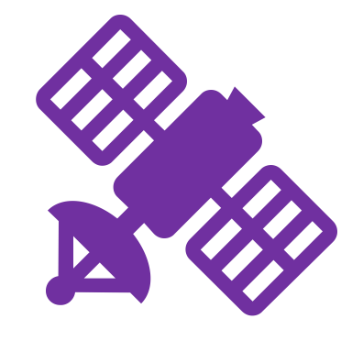



StarCDN uses consistent hashing across satellites
Orbit 1
Intra-orbital ISL
Orbit 2
Inter-orbital ISL
Orbit 3
Notes:
Treating satellites as part of the same cluster allows us to use techniques like consistent hashing. From high level, consistent hashing hashes contents to buckets and put buckets on different servers. In StarCDN, we also hash objects to one of several buckets and map each bucket to a different satellite. The number of buckets is tunnable and the tradeoffs are discussed in our paper but I will skip the discussion in my talk. Here we illustrate this using four buckets with four different colors. We repeatedly assign buckets in a gird pattern until all satellites have a bucket to serve. When request arrives, each satellite will hash the request to decide where to serve.

Slide 15



StarCDN uses consistent hashing across satellites
Orbit 1
Intra-orbital ISL
Orbit 2
Inter-orbital ISL
Orbit 3
I want yellow!
Notes:
This allows traffic to be aggregated together in the space. Suppose we have a user that is looking for the yellow object. He is lucky that he is connected to the yellow satellite. In this case, he gets the object directly form the satellite. If he is not lucky that he is connected to the purple satellite. The purple satellite will hash the request and redirect it to the yellow satellite. The user can be served without the need to duplicate the yellow content in anywhere except yellow satellites.

Slide 16


StarCDN uses consistent hashing across satellites
Orbit 1
Intra-orbital ISL
Orbit 2
Inter-orbital ISL
Consistent hashing improves hit rates by reducing duplication
Orbit 3
User 1
User 2
Notes:
Even users’ request changes or links are rescheduled, our consistent hashing redirects traffic to the correct serving satellite. With four buckets, a user’s request takes at most 2 hops to get to the right bucket so the latency overhead is affordable. This approach optimizes the utilization of storage capacity in a space by systematically aggregating traffics. We don’t need to duplicate content to every satellite now.

Slide 17





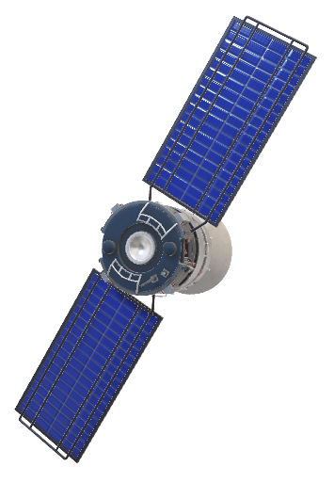

Challenge 2: Orbital motion causes drastic shift in content access pattern
Timestamp (min) | City
0 | Mexico City
7 | Atlanta
9 | Washington DC
9.5 | New York
23 | London
26 | Frankfurt
Satellite visits lots of cities in 30 minutes
Notes:
The second problem is the drastic access pattern shift caused by orbital motion. In terrestrial CDNs, each CDN server serves traffic from the same location almost all the time. This means that CDN servers usually do not see drastic shifts in access patterns. On the other hand, LEO satellites orbit around the Earth at speeds of around 8km per second and serve a given location for less than ten minutes. Here is the travelling footage of one satellite. You can see this satellite serves US at 9th minute and start serving London only 14 minutes later.
Note Make shorter on terrestrial CDN case. Explain more on the table.

Slide 18

How different are access patterns?
Notes:
One may ask, how different are access patterns and what’s the implication on hit rate? To quantitatively answer this, we compare traffic patterns across the world. We start at New York and gradually increase the distance to include nine cities around the world using Akamai’s production traces to see how traffic changes.

Slide 19
3 other US cities
Mexico City
London
For a single satellite, traffic patterns change rapidly
Notes:
Here is our plot. The x-axis encodes the distance away from new York city and the y-axis is the percentage of overlap for traffic and object. Even within united states, the percentage of overlap for objects drops to around 50% and overlap for traffic drops to 80%. As we moves out of US, both overlap in traffic and objects drop significantly. Even for English speaking metropolitan city like London, the overlap is very small. This means that if I take a cache serving New York and put it over London, the hit rate will drop by a lot. This is exactly the case for satellite networks. Such large access pattern difference, together with the high mobility of LEO satellites is a huge challenge.

Slide 20
Idea: Move popular content in the opposite direction of orbital motion via relayed fetch
Notes:
To solve this, let try to figure out the access pattern for the region we are about to serve and move the content against the orbital motion. Importantly we want to do IN SPACE so that we don’t need to rely on satellite uplink.

Slide 21
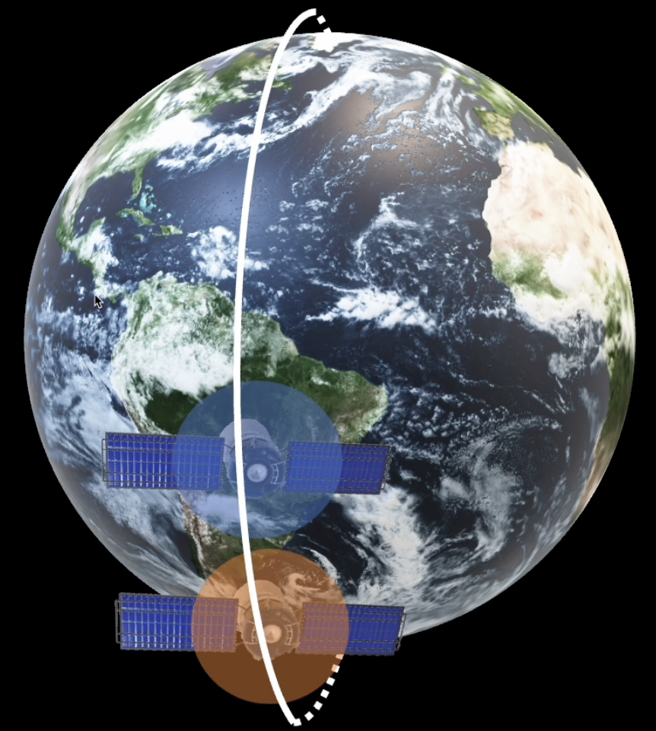
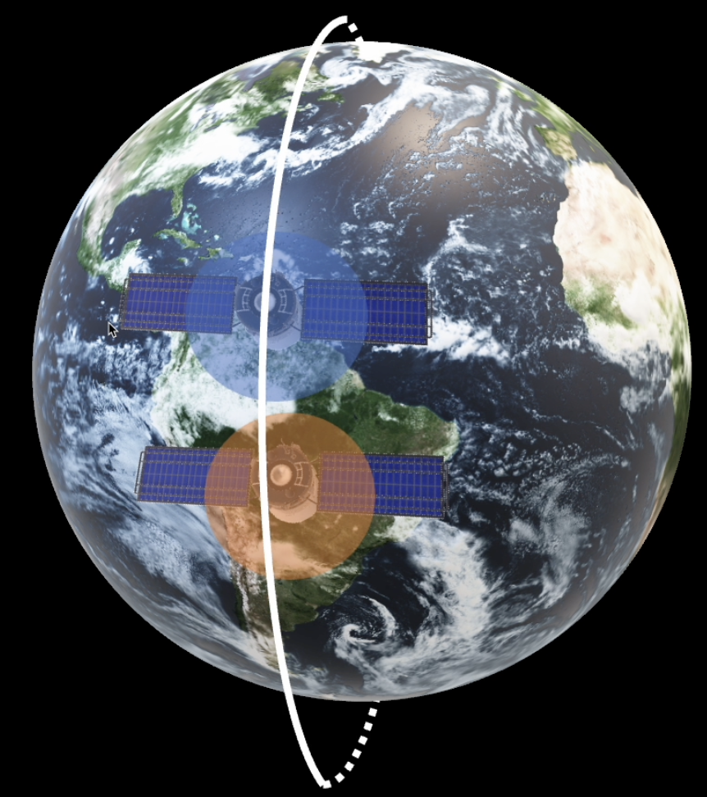

Your neighbor knows what you need
t=0
t=15
Notes:
In order to find how to flow content, we first need to identify where are the useful information. Here are two satellites in the same orbit going front and back with coverage range shown in two colors. Let take two snapshots around 15 minutes apart. We can see that the blue satellite, 15 minutes ago, had served very similar locations as what the orange satellite is serving right now. From orange satellite’s view, its next neighbor in orbit has the content it needs right now.

Slide 22

Relayed fetch from neighbors as needed
Orbit 1
Intra-orbital ISL
Orbit 2
Inter-orbital ISL
Popular contents flow against orbital motion overcoming the access pattern drifts
Orbit 3
I want yellow!
Notes:
With this in mind, all we need to do is to ask neighbors for what you need before going to the ground. When user’s request is a cache miss, cache server will send queries to neighbors who might have the wanted content because they were in the same region several minutes ago. This effectively creates a flow of popular content in the space in the opposite the direction of orbital motion. Now our satellites can adapt to drastically changing access patterns.

Slide 23
Same orbit satellites are far away
Orbit 1
Intra-orbital ISL
Orbit 2
RTT=8ms
Inter-orbital ISL
Orbit 3
RTT=32ms
Notes:
There are some tradeoffs here. In starlink’s topology, distance between satellites in the same orbit is much larger than the distance between parallel satellites. So fetching from your neighbors in different orbits will be more latency friendly. Surprisingly, your neighbors in different orbits also have very rich access pattern information that we can utilize and we can relay fetch from them. Due to time limitation, I will leave this part of detail to our paper.

Slide 24
Evaluation
Notes:
Now, let's discuss the evaluation of StarCDN.

Slide 25
Challenge 3: Need content access traces across the globe
Notes:
To evaluate our design, we need realistic access patterns from many places. This is hard to find because such traces are usually sensitive to CDN companies.

Slide 26
Idea: High fidelity distributed trace generation
Notes:
So to address our and the research communities’ need, we enable high quality trace generation. There are previously works on generating accurate synthetic trace for a single server’s traffic. We built SpaceGEN , the FIRST tool on top of previous theories, to make this happen for multiple traces from multiple locations.

Slide 27









SpaceGEN: first open-sourced generator for geo-distributed content access traces
Real-Trace for Location ‘X’, ’Y’, ‘Z’…
Synthetic-Trace for Location ‘X’, ‘Y’, ‘Z’…
Popularity Footprint Descriptor
Global
Correlation
X times
US
How objects are accessed within a trace
How objects are accessed between traces
Y times
x bytes access y times
revisit after z bytes…
UK
Z times
JP
Notes:
From a high level, sapceGEN takes several real traces as inputs. The statistics extractor will extract popularity footprint descriptor for each traces. Each footprint descriptor contains information about object size, number of access and hit rate and so on. We also extract a global correlation which captures how contents are accessed across different traces. These statistics are anomalized, concise, and publishable. Finally, our algorithm uses these statistics generate high-fidelity synthetic traces. This framework provides an end-to-end flow for publishing traces.

Slide 28
Synthetic traces have similar properties to real traces
Notes:
We want to briefly show the highlight of our generator. Here on the left, we have the CDF for the number of traces an object exists in. For example if game of throne appears in all nine traces, it will contribute to an object spread of 9. This is a metric for object correlation between traces and you can see the gap is very small. On the right we have aggregated traces request hit rate over different cache size in giga-bytes. when we replay each trace and again we have a very small difference.
Note: This is the "detail" slide for generator.

Slide 29
StarCDN: Evaluation Setup
5-days-long synthetic traces generated from Akamai’s production traces
Microsoft’s CosmicBeats Simulation with cache replayer
We simulate for 5 days using Starlink’s gen-1 53 deg constellation
Notes:
Now let’s look into the evaluation of StarCDN. We generate 5-days-long synthetic traces from production traces and setup simulation framework using Microsoft’s CosmicBeats with cache replayer. Our trace has 2 billion requests and 2.5PB of traffic. We run 5 days of simulation using Starlink’s gen-1 53 degree inclination constellation with more than 1000 satellites by collecting their latest two line elements for their precise orbital motion.

Slide 30
StarCDN improves cache hit rate
15%
Improvement on other traces
Web trace: 10%
Download trace: 27%
Notes:
Here is the main result of our work, the byte hit rate of StarCDN over 5 days of global video traffic. On the X-axis we have cache size in giga byte and on the y axis we have the byte hit rate. This orange curve represents the hit rate of our baseline, which is placing LRU caches directly over satellite. StarCDN provides a maximum byte hit rate improvement of 15%. At the cache size of 100GB, StarCDN can save around 80% of earth-to-space bandwidth usage with its high hit rate. Here we also plot the optimal hit rate in the ideal case when there are no orbital motions at all. We also evaluate StarCDN over web and download traffics to see how our design works on different traffic classes. StarCDN yields 10 byte hit rate improvement for web traffic and 27% improvement for downloads. This helps improve latency
Note: LRU->Baseline. explain more on the LRU baseline.

Slide 31
StarCDN: Other results overview
Ablation study
Latency
Bucket size tradeoff
Relay fetch tradeoff
Fault tolerance
Different traffic classes
SpaceGEN empirical evaluation
Notes:
You can also find other detailed reults in our paper including ablation study, latency, various design tradeoffs, and so on.

Slide 32


Conclusion
StarCDN presents a novel CDN architecture that optimizes satellite network user experience and satellite link utilization
Two architectural features: Consistent hashing for satellites, relayed fetch
We released SpaceGEN, a novel synthetic trace generation for LEO satellites evaluations
Simulator
SpaceGEN
Notes:
To sum up. We present a novel CDN architecture to optimize satellite network user experience and uplink usage using consistent hashing and relayed fetch. We release our synthetic trace generation framework to enable large scale evaluation. If you are interested in our dataset and codes feel free to check this link. This concludes my talk and I’m happy to take questions.

